Slide 1

Access Developer Day
Amsterdam, Netherlands
October 2018
Michal Bar
Access Program Manager, Microsoft
michal.bar@Microsoft.com

Slide 2



Slide 3



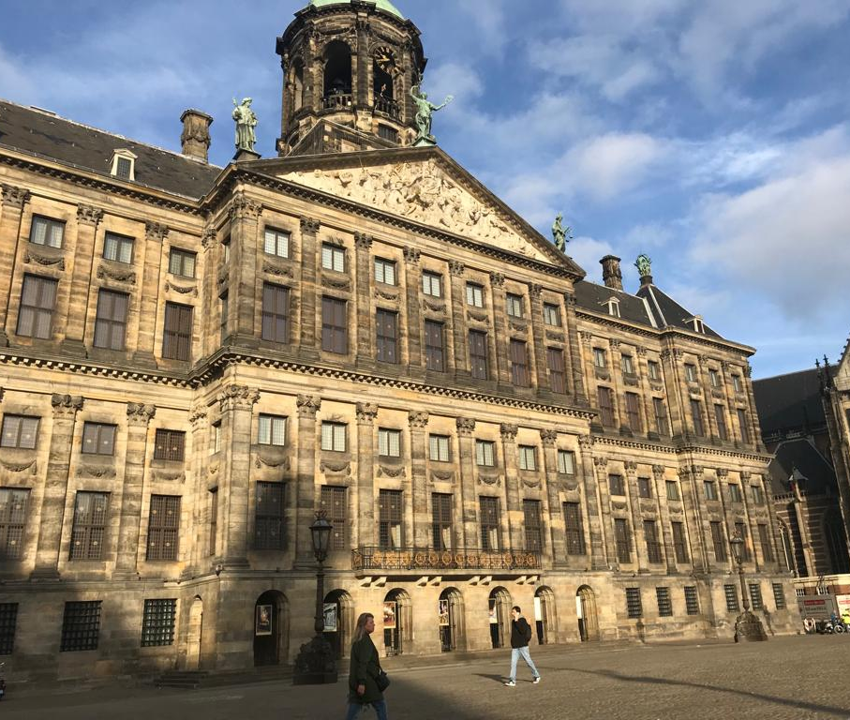


Slide 4
Agenda
Current state of Access
  Recent investments
  Roadmap
Community engagement
Q & A

Slide 5

Current State

Slide 6

CURRENT STATE

Slide 7
Modern charts

Slide 8
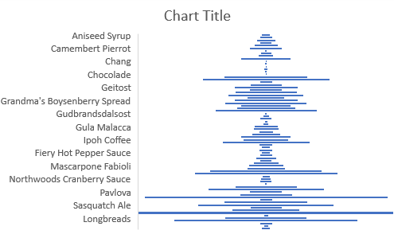
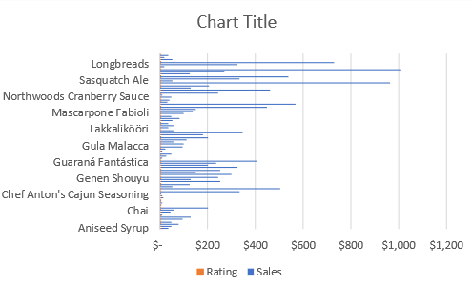
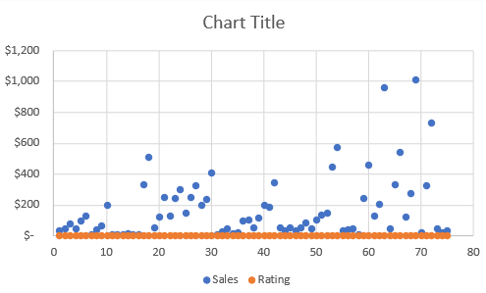
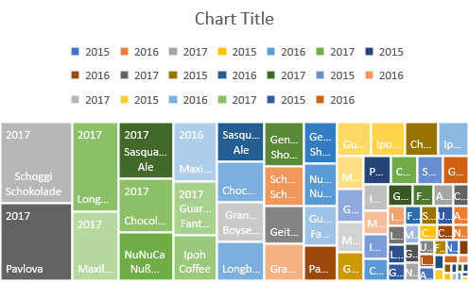
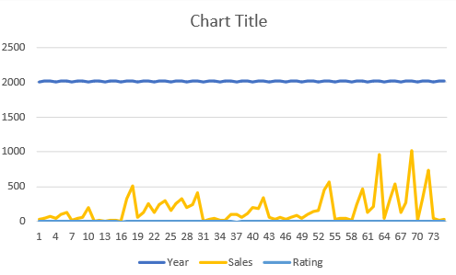
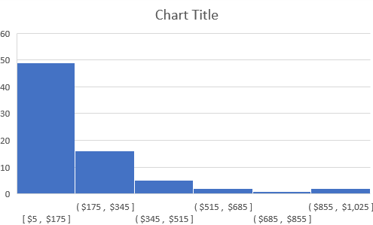
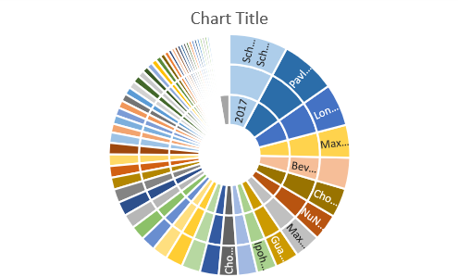
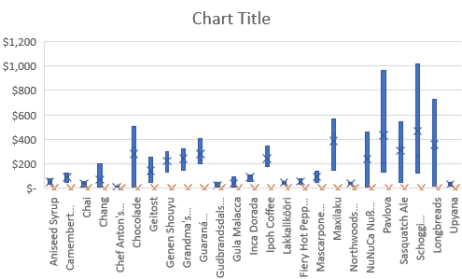
MODERN CHARTS
Help people understand the significance of data by placing it in a visual context

Slide 9






What did we learn from customers?
MODERN CHARTS
Key scenario
Selling Point
PivotCharts
Current and Modern
Design Experience
Export to Excel

Slide 10
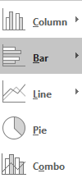
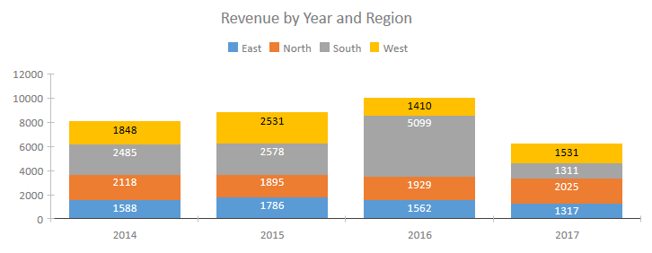

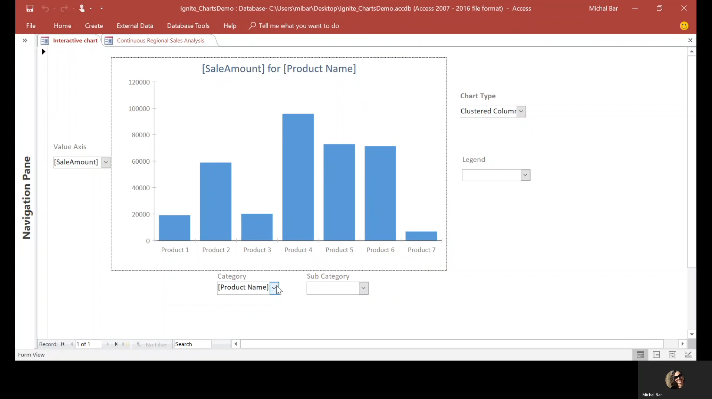
MODERN CHARTS
New modern charts
Modern look and feel
Friendly user experience
Interactive charts

Slide 11




Demo

Slide 12


Linked Table Manager

Slide 13
What did we learn from customers?
LINKED TABLE MANAGER
Usability
Functionality

Slide 14
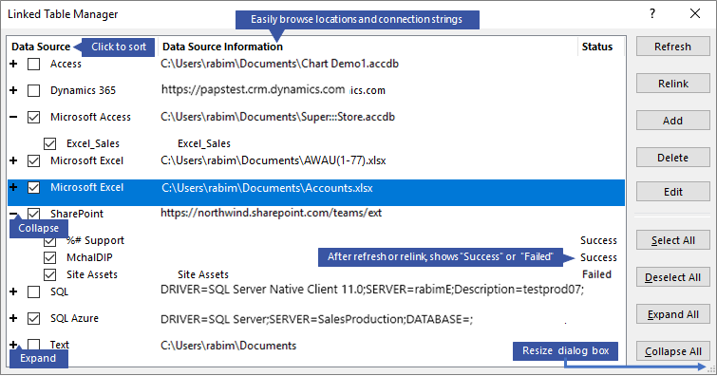

Slide 15

Roadmap

Slide 16
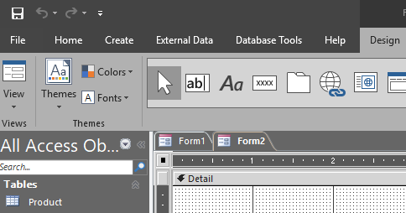
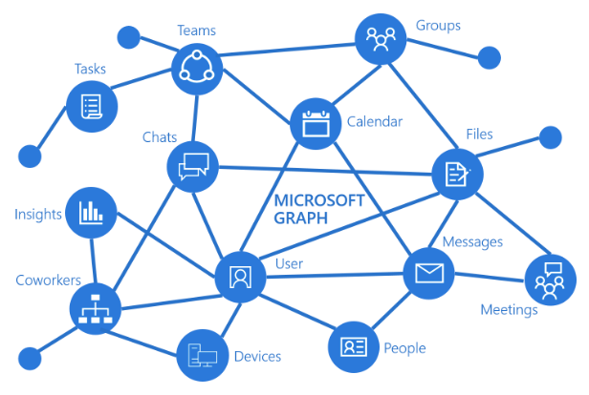
On the horizon
ROADMAP
Black and Dark Gray themes support
Connect to Microsoft Graph
O365 public roadmap https://products.office.com/business/office-365-roadmap

Slide 17

Community Engagement
Notes:
Deliver value to customers
Help customers stay current

Slide 18




COMMUNITY ENGAGEMENT
RESPOND TO FEEDBACK
PRODUCT TEAM VISIBILITY
CUSTOMER CONNECTION
EVENTS PRESENCE
In app feedback
User Voice
O365 public roadmap
Access Blog
Customer visits and interviews
Users group speaking
Conferences/Access Days

Slide 19


Become an Office Insider
Receive early exclusive monthly upgrades and new features
Tell us what you think and help shape the future of Office
office.com/insider
Join the program
@OfficeInsider
Tweet us
aka.ms/
OfficeInsiderCommunity
Be part of our community
Available for Windows Desktop | Mac® | Windows Mobile | Android™ | iOS®

Slide 20

Q & A

