Slide 1
Microsoft Access Database Evolution from the Desktop to the Cloud
Presented by Luke Chung
President and Founder
FMS, Inc.

Slide 2


About Me
FMS, Inc.
32nd Year
Founded 1986
President and Founder of FMS, Inc.
  In Vienna, Virginia, near Washington DC
  Designer of all products and primary
  author of several
  Developer of many custom database solutions
  with Microsoft Access and SQL Server
Microsoft Access MVP since 2010
Past President of the Washington DC Chapter of the Entrepreneurs Organization
Graduate of Harvard as an Engineer and Physical Oceanographer

Slide 3
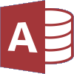
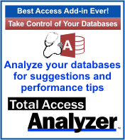
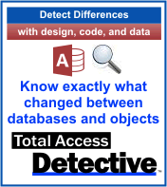

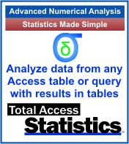
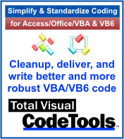
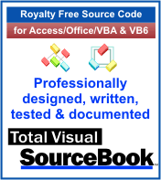

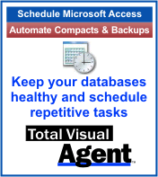

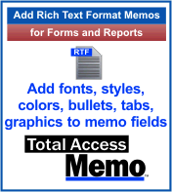

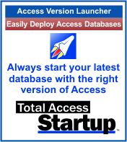
World’s leading developer of 3rd party products for Microsoft Access

Slide 4
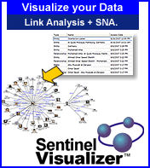

Sentinel Visualizer
Advanced data analytics with link charts, geospatial timelines, social network analysis (SNA) metrics
Sentinel Visualizer Product for counter-terrorism, law enforcement, defense, fraud detection, etc.
Led to investment by InQTel, the CIA’s venture capital arm – our only outside investor
Visual Studio .NET and SQL Server
http://SentinelVisualizer.com

Slide 5
Access Database Evolution from the Desktop to the Cloud
Access and Database Evolution
Single Database
Split Database
Supporting Different Access Versions
ACCDE/MDE deployments
Upsizing to SQL Server
Hosting SQL Server on the Azure
Remote Desktop/Remote App
Virtual Machines on Azure

Slide 6
Database Evolution
Databases evolve over time
  Some grow and become more sophisticated
  Even desktop databases become mission critical
  Many die and go extinct
    Bad design or developer
    Business needs change
How do you determine which survive?
How do you plan for casualties?
How do you maximize Return on Investment (ROI)?

Slide 7
Military Analogy
A commanding officer faces a wide range of threats and is given a wide range of weapons
  Why do they need bullets if they have planes?
  Infantry play an important role
  Others support infantry (e.g. air support)
CIO/CTOs face a battlefield with a wide range of database challenges
Organizations should have:
  A wide range of tools appropriate for each challenge
  Readiness to provide support when infantry gets overwhelmed

Slide 8
Strategic vs. Tactical
Access is a tactical weapon
  The infantry on the database battlefield
  It’s great for quick and dirty situations
  It gets the job done when more sophisticated solutions are unnecessary, unavailable or too expensive
Expect less sophisticated solutions
  There will be friendly fire
Anticipate providing support when infantry gets into more trouble than they expected
  Great generals have support trained and ready
  Infantry are trained to ask for support
  Good generals don’t complain or withhold support when it’s requested. They respond with overwhelming force.

Slide 9
Access Fills an Important Segment
Different database problems require different solutions
Excel holds more user data than other platforms
  It’s not a database but it works for many situations
  Basic analysis, not database workflow applications
Database solutions justified by current value
  Microsoft Access fills this large and important segment
  Information Workers are empowered to extend and enhance Access solutions unlike other platforms
Larger databases, more users, more valuable data, and more sophisticated requirements such as web apps are solved with hybrid SQL Server/Azure

Slide 10
Access Single Database
Most Basic: Everything is in one database
Advantages
  Easy for one user; good start
  Simple to change table structures
  Easy to distribute, copy, even email
  Useable in disconnected environments
Disadvantages
  Not ideal for multiuser data sharing
  Can’t separate development from user
  Hard to update others if data changes

Slide 11
Split Database Architecture
Separate data (tables) from application
Back-end database only contains tables
Front-end database is the application layer and links to the back-end tables
  Queries
  Forms, Reports
  Macros
  Modules
Front-end database contains user tables
  Keeps user selections separate from shared data

Slide 12
Split Database Architecture Advantages
Multiuser Support
  Data is shared by all users across a network
  Minimize database corruption
Improve performance with local database
Front-end updates without losing data
  Developer can add new features and test them before deployment against test or live data
  Deployments made without updating tables
Network backup and compact of back end database
Scalability with multiple backend databases >2 GB

Slide 13
Split Database Architecture Disadvantages
Each user needs a copy of the front-end database
  Need to update when the master database is updated
More complicated to change table structures since it is done on the backend
  Plus: Linked tables to Access automatically update when structures change
  Not the case for SQL Server tables which need to be relinked for structural changes
Dependencies in table design may be an issue
  Lookup lists based on queries

Slide 14
Split Database Paper with More Resources
Paper discussing split database issues
  http://fmsinc.com/MicrosoftAccess/
  DatabaseSplitter/
Access split database wizard
VBA code for relinking tables
  From Total Visual SourceBook library
Adjusting SEEK statements
Total Access Startup for deploying your latest update and launching the right Access version

Slide 15
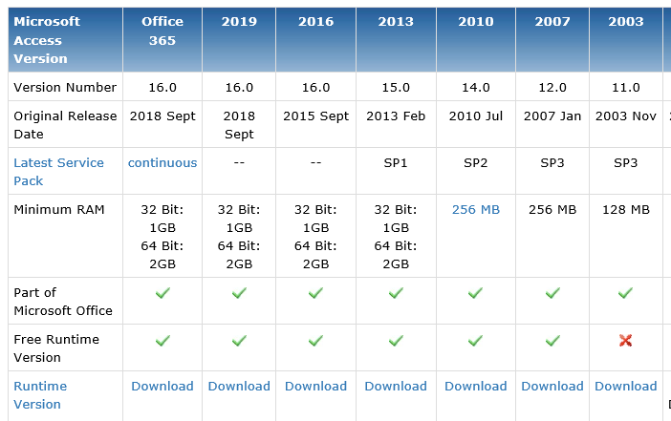
Access Version Comparison Matrix
Access version differences
http://fmsinc.com/MicrosoftAccess/history/features.htm
Make sure you build (or at least test) in the oldest Access version of your users

Slide 16
Deploying ACCDE Databases
ACCDE (or MDE) databases are more secure and professional
If user opens the database
  Cannot modify forms, reports, and modules
  Can modify macros, tables, and queries
Eliminates users encountering a Debug Cancel message and getting into the code
Requires solid and comprehensive error handling to trap unexpected crashes

Slide 17
Upsizing the Back-end Access Database to SQL Server
Replace the Access back-end database (tables) with a SQL Server database
Advantages
  More secure than file server solutions
  More scalable
    SQL Server databases break the 2 GB limit
    SQL Server databases can be shared with more applications especially web solutions
  Less network traffic since only requested records are delivered

Slide 18
Viewing SQL Server Tables
Is Not Live
Viewing SQL Server data is not live
  SQL Server data needs to be refreshed (requeried) to see latest values
  Access data is automatically updated when the data changes. View a datasheet and watch updates.
SQL Server tables are not locked
Conflicts noticed when modified record is posted
  Access records can be locked when user starts to edit
  Other user notified if they try to modify the record

Slide 19
Additional SQL Server Upsizing Issues
New SQL Server records create AutoNumber (Identity) value AFTER the record is saved
  Access creates it as soon as a new record is added
Sensitive to setting default values for fields
May not improve performance, especially on small databases
May need to redesign Access applications
  Fix queries to handle VBA differences
  Address performance issues
  Pass through queries or SQL Server views
Ability to write stored procedures is critical

Slide 20
Use SQL Express for Local Development and Testing
A limited version of SQL Server installed on your PC
  Database up to 10 GB
Latest version is SQL Server 2017
Free download:
  https://www.microsoft.com/en-us/sql-server/sql-server-downloads
SQL Express versions and differences with download links
  http://fmsinc.com/MicrosoftAccess/SQLServerUpsizing/express/

Slide 21
Linking to SQL Server Tables
Need to install recent ODBC driver
  Built-in SQL Server driver is for ancient versions of SQL Server (2000?)
  Currently: ODBC Driver 17 for SQL Server
User must have proper permissions to connect
  Windows Authentication or user login
  Allowable IP address
If a SQL Server’s table structure changes, Access needs to relink to it

Slide 22
Additional SQL Server Resources
Our papers Access SQL Upsizing Center
  http://fmsinc.com/MicrosoftAccess/SQLServerUpsizing/
Microsoft download for SQL Server 17 ODBC driver
  https://microsoft.com/en-us/download/details.aspx?id=56567

Slide 23
Hosting SQL Server on the
Microsoft Azure cloud
SQL Azure is part of Microsoft Azure
  Microsoft handles hardware, updates, licenses
Enterprise quality database hosting
  Hosted in a secure data center
  Very high availability
  Scalable as database grows
  Database mirrored on 3 hard disks
  Transaction logging with up to the second database recovery

Slide 24
SQL Azure Pricing
Basic
  2 GB database with 5 Database Transaction Units (DTUs)
  7 days of backup recovery
  $5/month
Standard
  250 GB database, 10 DTU, one month of backup recovery
  $15/month
Elastic Pools share resources across multiple databases (~$120/mo. for 50 DTU)
  Individual databases can utilize higher DTU
  No per database fee
  Ideal for databases with fluctuating usage levels

Slide 25
How to Add a Database to SQL Azure
Create an Azure Subscription
Use Azure Portal:
  https://portal.azure.com
Create a SQL Server (free)
Add a database to the SQL Server
  Configure pricing for your level
  Get database connection information

Slide 26
Publishing a SQL Server Database to SQL Azure
From SQL Server Management Studio publish the database to SQL Azure
Make sure transaction logs are truncated

Slide 27
Linking to a SQL Azure Database
Subject to same security permissions as on-premise SQL Server
Unlike local SQL Server, need to specify allowed IP addresses, unless open to all
  Requires specific or range of IP addresses for a fixed location or VPN
  Allowed IP settings at SQL server and database level
  NOTE: Database IP settings take precedence over server IP addresses

Slide 28
SQL Azure Resources
Linking to SQL Server Tables in Azure
  http://fmsinc.com/MicrosoftAccess/cloud/link-to-azure-sql-database.html
Moving Microsoft Azure SQL Server Databases to SQL Elastic Pools
  http://fmsinc.com/microsoft-azure/sql-server/pooled/

Slide 29
Remote App with Access
Addresses a portion of applications that need to support users “over the Internet/Intranet”
  Want to run an application without installing it
  Not a request for HTML pages in a web browser
  Independent of operating systems such as Macs
Remote App and Remote Desktop are part of Windows server using Terminal Services to host multiple users
Each user runs their own instance of Access and Access database

Slide 30
Remote App
Remote App is similar to Remote Desktop
User can only run one application
Prevents users from running other programs
Prevents users changing their Windows desktop, files, etc.
Remote App can be configured so a user running multiple apps shares the same O/S

Slide 31
Remote App Advantages
Simplifies deployment: No need to install Access and your database on each user’s PC
More maintainable: Centralized control of Windows and Access versions
Easier to debug problems
Supports Mac users
Can support all internal Windows applications

Slide 32
Remote App Limitations
Number of concurrent users limited by server hardware
  Depends what resources the application requires
  Around 20-50 simultaneous users
Not as scalable as web solutions which can support hundreds or thousands

Slide 33
Implementing Remote App with Access Solutions
Access should be a Split Database application
Back-end database can be on the network, a SQL Server database, or anything else Access supports
Front end database should be deployed to each user’s profile folder
  e.g. C:\Users\Name\MyDocuments

Slide 34
Preparation of Windows Server for Remote App
Need admin permissions
Make sure the right version of Access is installed, or install the Access Runtime
Interactively test and verify you can run the Access application on the server
Make sure network connections to linked tables work

Slide 35
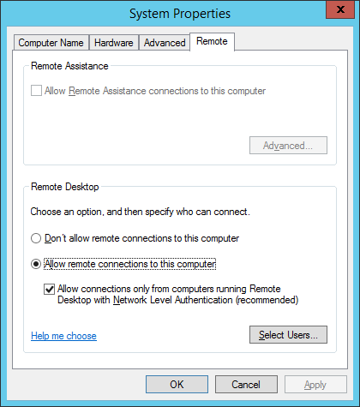
Server Must Allow Remote Connections
System Properties
Remote tab
Select: Allow remote connections to this computer
Check: Allow connections …

Slide 36
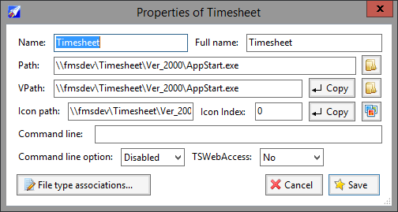
RemoteApp Tool from Kim Knight
Free tool to create RDP file to launch RemoteApp
  http://www.kimknight.net/remoteapptool

Slide 37
Remote App Resources
Paper: Using Terminal Services and RemoteApp to Extend Your Microsoft Access and other Windows Applications Over the Internet
  http://fmsinc.com/MicrosoftAccess/terminal-services/remoteapp.htm

Slide 38
Hosting Virtual Machines on Azure
Instead of your own server, you can use an Azure VM to host Access applications using Remote App
Backend database needs to be accessible by the VM
  Cannot be an Access database on your network
  Can be SQL Azure, ideally in the same data center

Slide 39
Access Addresses Database Evolution
Access solutions range from the desktop the cloud
Hybrid solutions combine the strengths of the desktop and cloud
Access has a cost, migration and evolution story to support the life cycle of database solutions

Slide 40
FMS Resource Centers (FREE)
Microsoft Access Developer Papers
  http://fmsinc.com/MicrosoftAccess/developer/
Microsoft Access Query Center
  http://fmsinc.com/MicrosoftAccess/query/help-center.html
Microsoft Access Upsizing Center
  http://fmsinc.com/MicrosoftAccess/SQLServerUpsizing/
Outlook Tips
  https://fmsinc.com/MicrosoftOutlook/

Slide 41




FMS Social Media
Social Media
  http://blog.fmsinc.com
  https://facebook.com/MicrosoftAccessProducts
  @fmsinc and @LukeChung
Email Newsletter
http://fmsinc.com/contactus
News Media
http://fmsinc.com/news/media.htm

