Slide 1

Designing Task-Driven Apps
Goal
Make you think differently about
the design of your applications
Tom van Stiphout
tom7744@cox.net

Slide 2

More Competitive
We have better products/services
We have better apps
We have better users
Increased complexity
Minimize training time
Minimize time to perform task
Supervisor visibility in work getting completed

Slide 3
Task Driven vs. CRUD
CRUD best for:
Simpler applications
Low-value applications
Based on features and data objects
Task Driven best for:
More complex applications
High-value enterprise systems
Based on workflow and user intent

Slide 4
Task Definition
Who
What
How (context, instructions, data)
By When
Sequential flow
Parallel flow
Escalation
Cancellation
Assignment
Reminders
Typical Actions

Slide 5
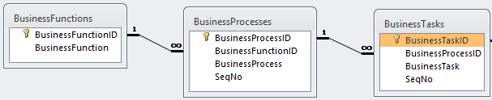
Task Driven Analysis
Example: Northwind
Example: SLAP

Slide 6
BusinessFunction | BusinessProcess | BusinessTask
Online Grocery | Order Processing | Take Order
Online Grocery | Order Processing | Invoice Order
Online Grocery | Order Processing | Ship Order
Online Grocery | Inventory Management | Order Products
Online Grocery | Inventory Management | Approve Purchase
Online Grocery | Inventory Management | Submit PO
Online Grocery | Inventory Management | Receive Inventory

Slide 7
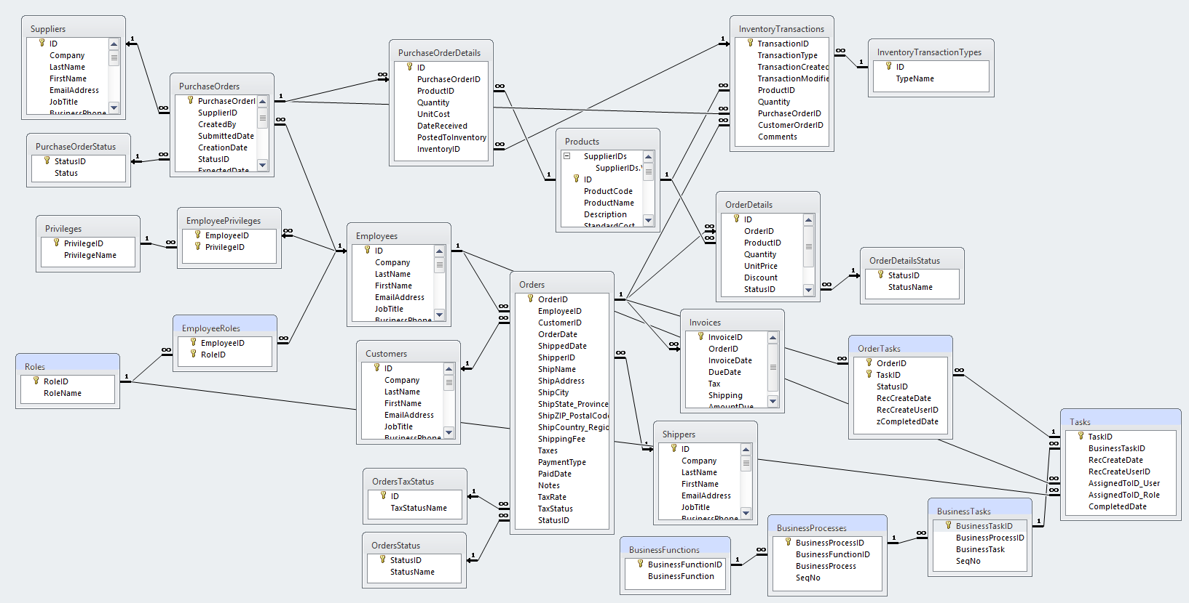
Notes:
Last slide before Summary.

Slide 8

Questions?
Make you think differently about
the design of your applications
For more complex, high value apps
Focus on workflow and user intent
Results in:
Tasks performed accurately and fast
For a more competitive business
Tom van Stiphout
tom7744@cox.net

Slide 9
Evolution
Tell me what you want, and I will build that.
Tell me what you want, and I will find the best way to build that.
Tell me what you do, and I will find the best way to support that.

